Slide 1




Data Downloads: Overview and Portals
Pam Soltis
University of Florida

Slide 2
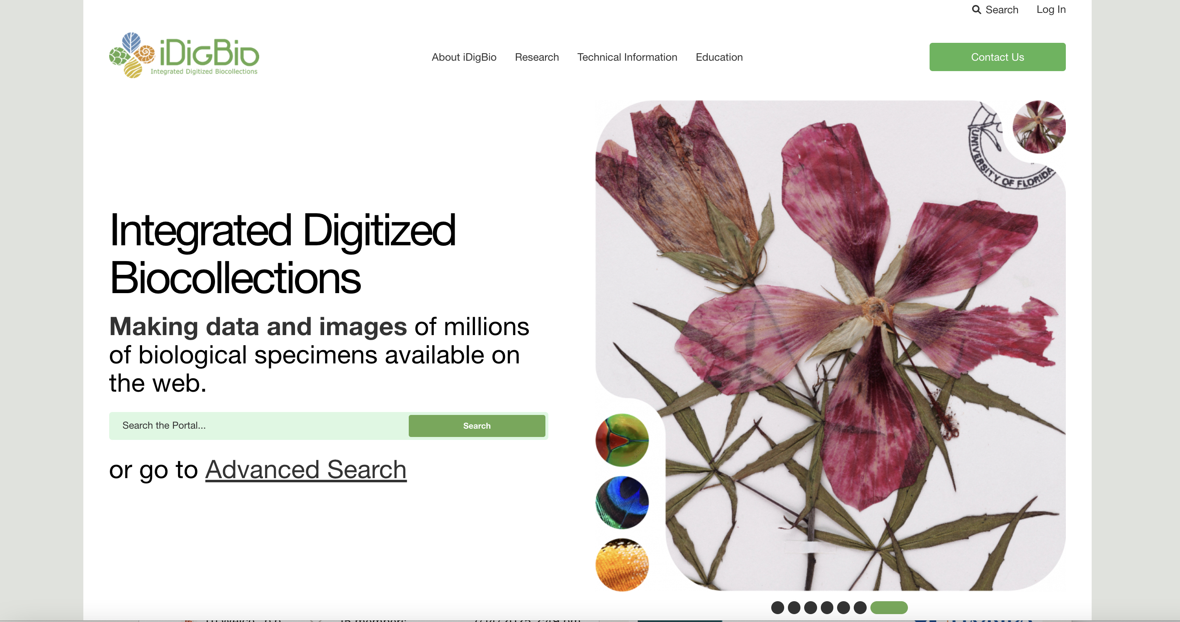

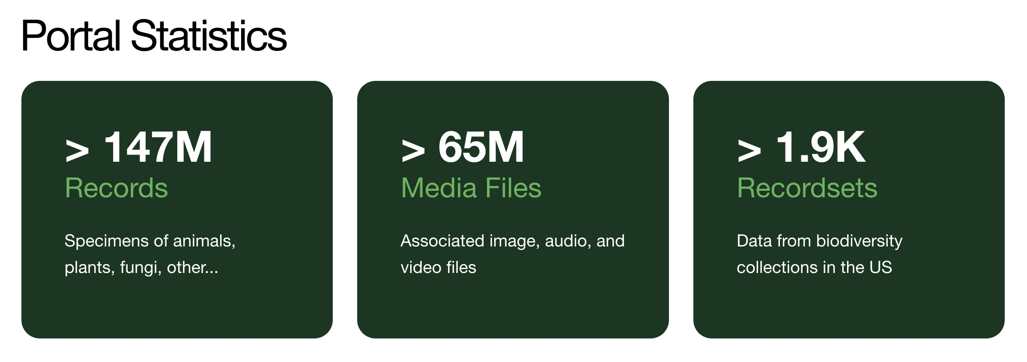
iDigBio: A Source for Specimen Records

Slide 3
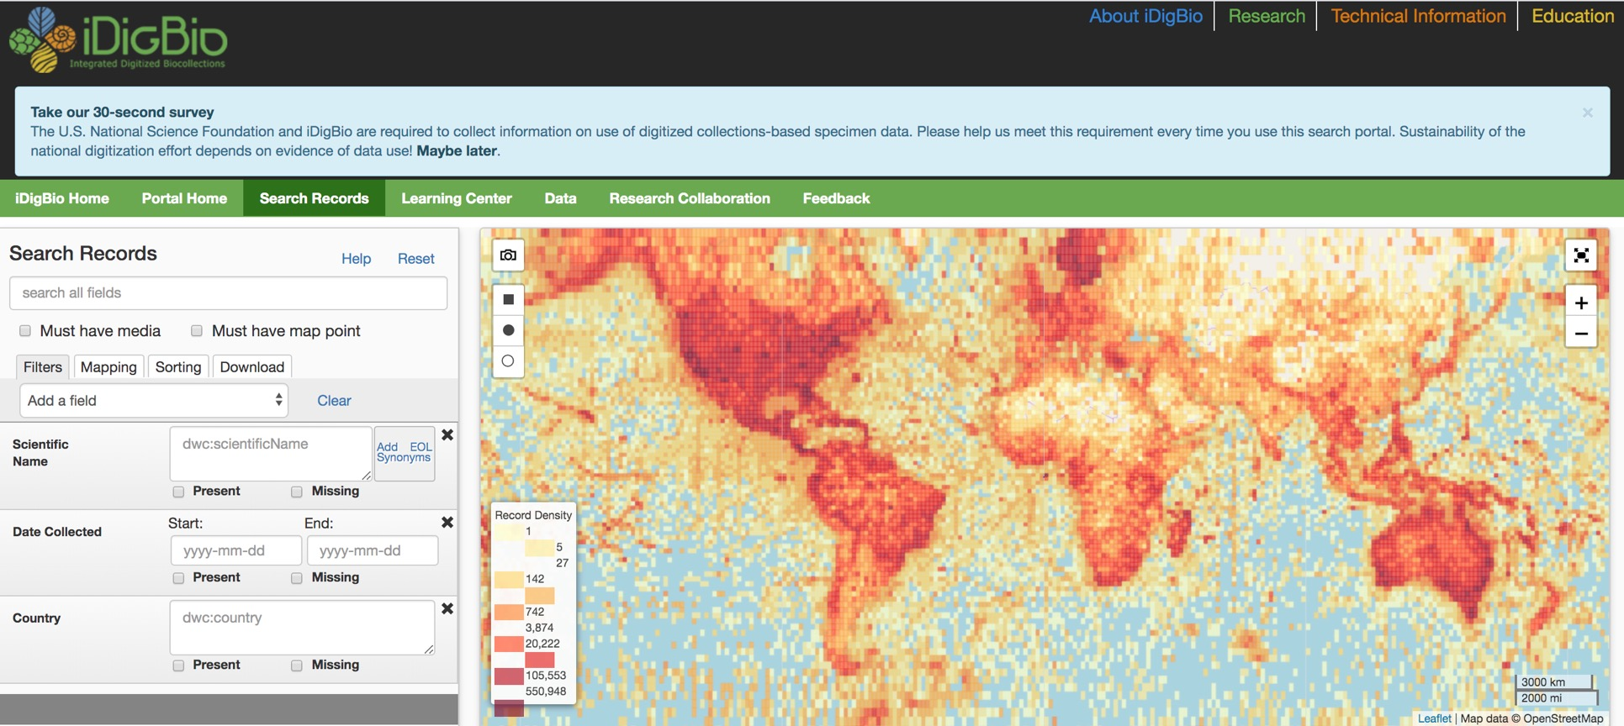
Search the iDigBio Portal

Slide 4
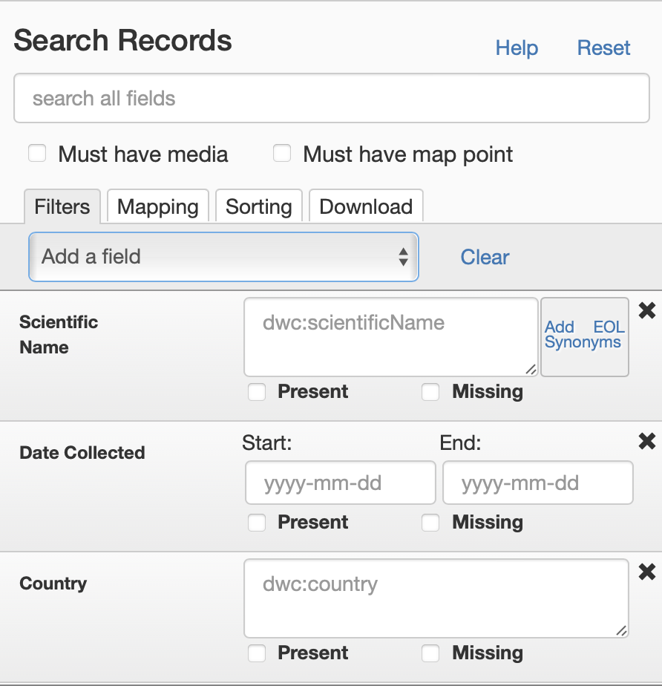
Search the iDigBio Portal – Specify Search Criteria

Slide 5
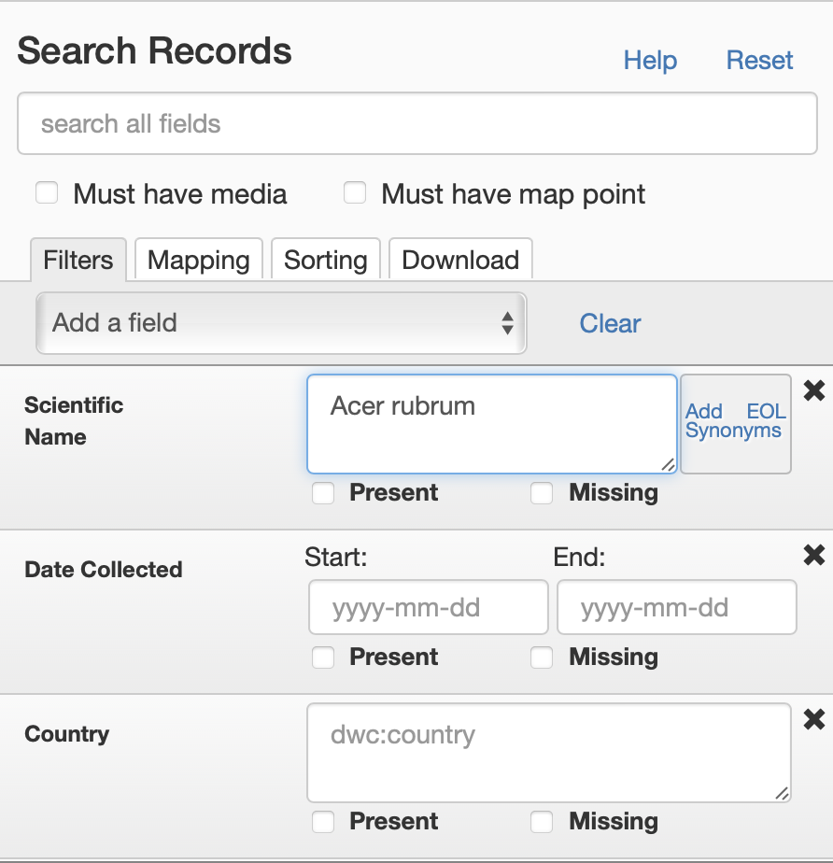
Search the iDigBio Portal – Specify Search Criteria

Slide 6
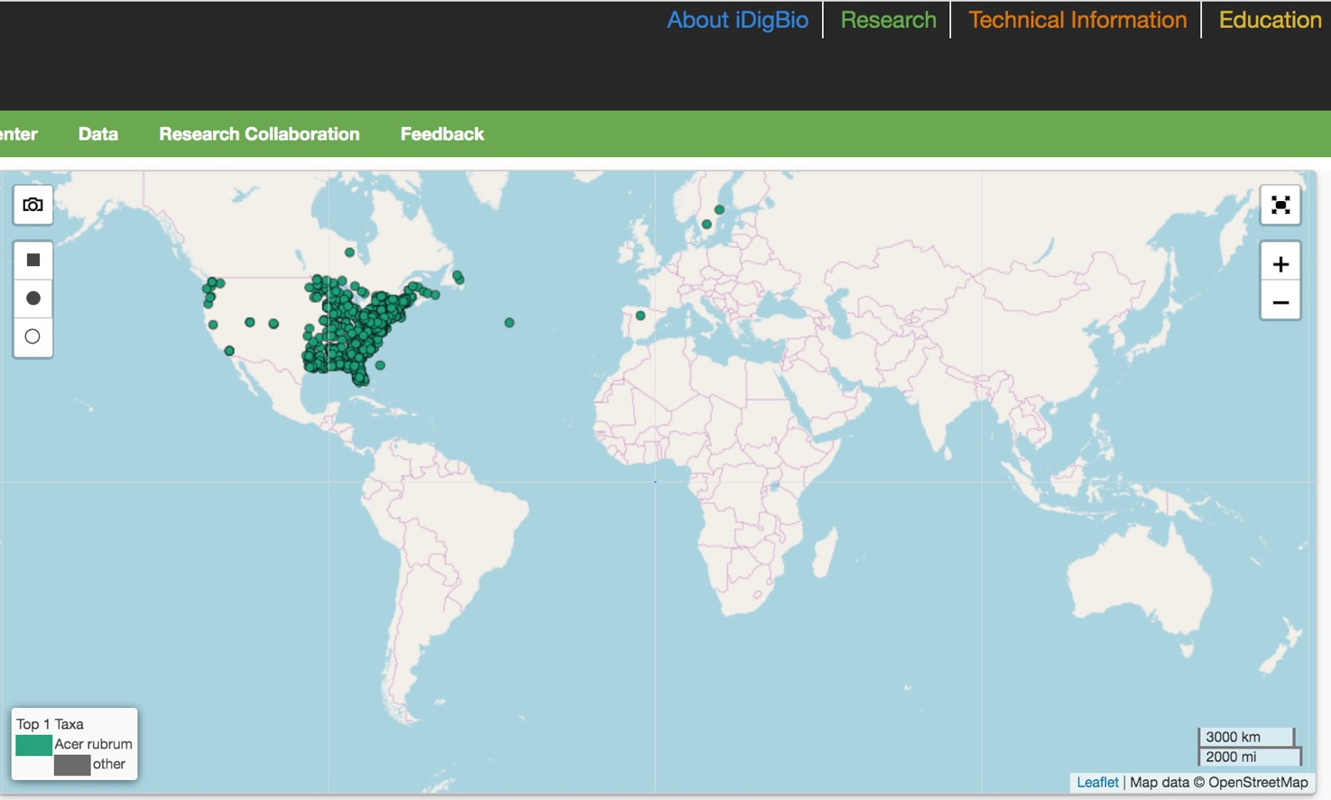
Search the iDigBio Portal – Results

Slide 7
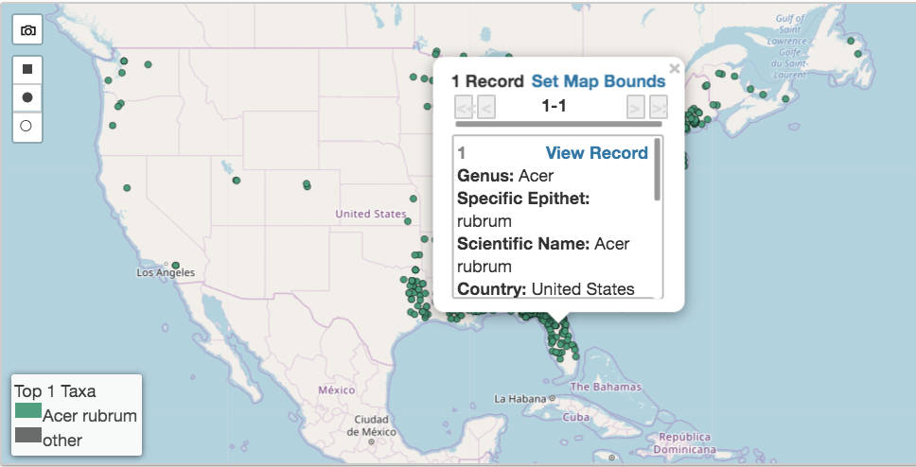
Search the iDigBio Portal – Record Summary

Slide 8
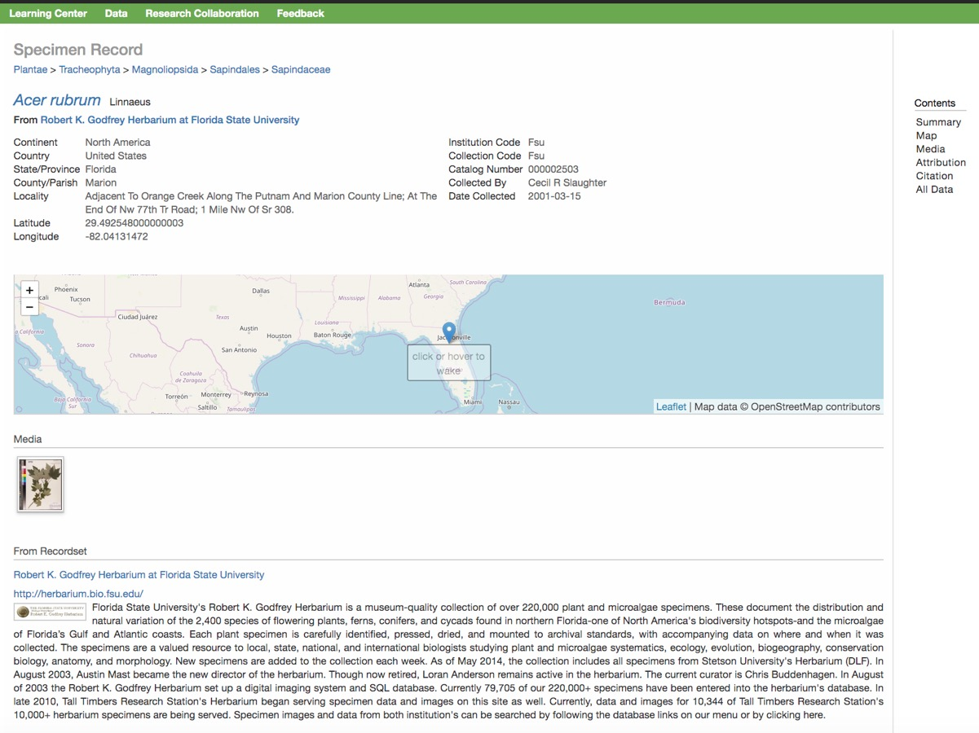
Search the iDigBio Portal – Specimen Record

Slide 9
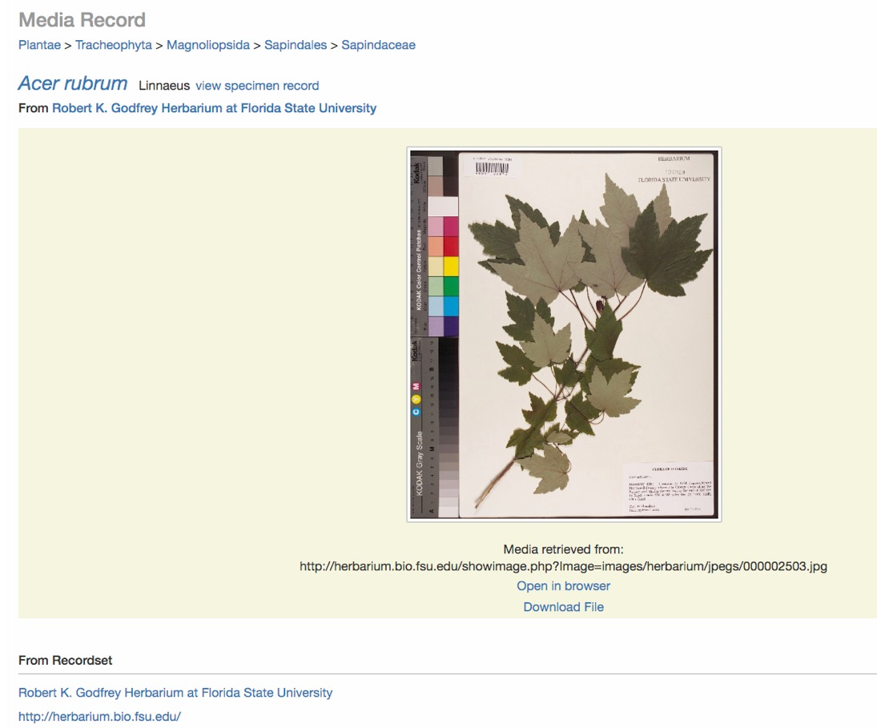
Search the iDigBio Portal – Link to Media Record (Image)

Slide 10
Search the iDigBio Portal

Slide 11
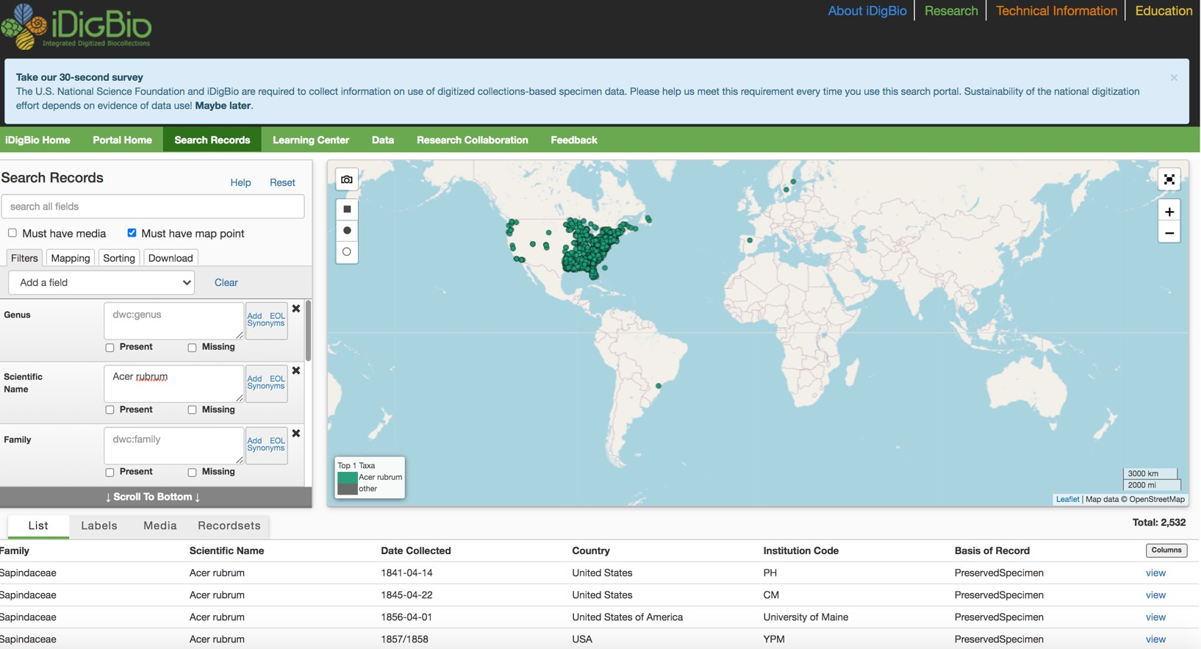
Search the iDigBio Portal: List of Data Records

Slide 12
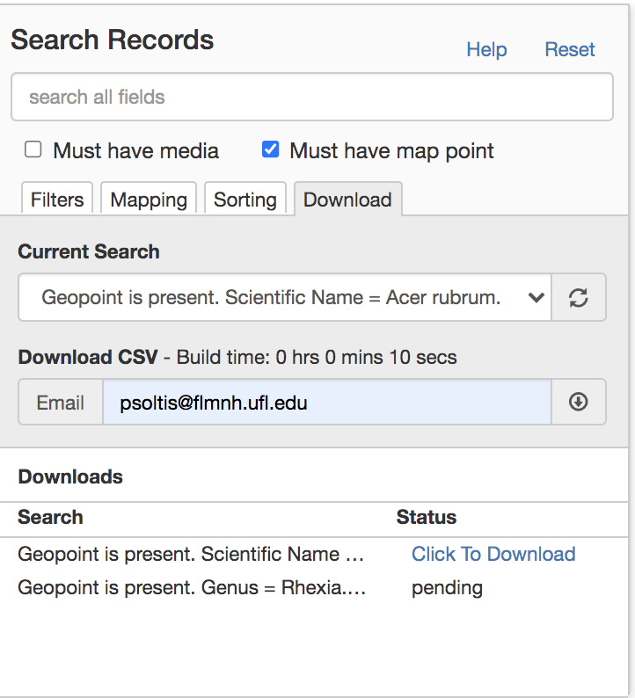
Search the iDigBio Portal: Download csv

Slide 13
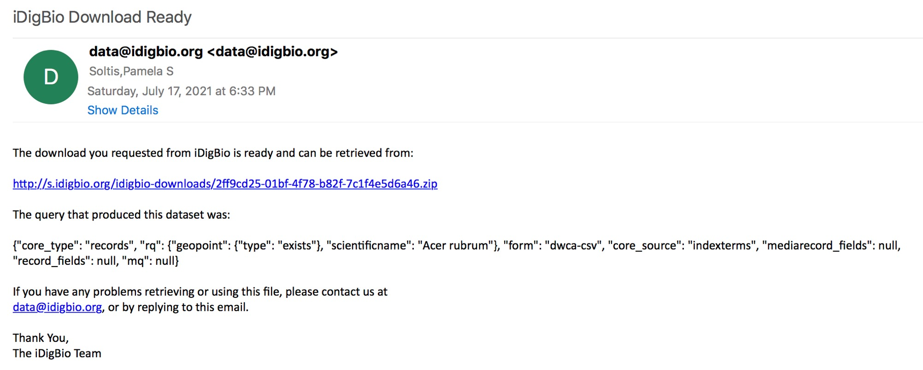
Search the iDigBio Portal: Email Download Link

Slide 14
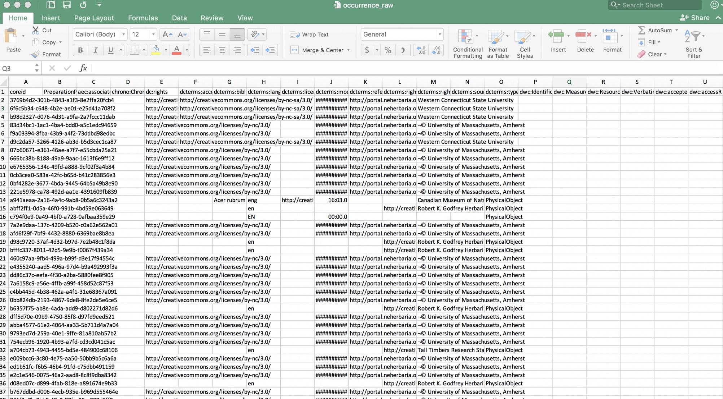
Search the iDigBio Portal

Slide 15
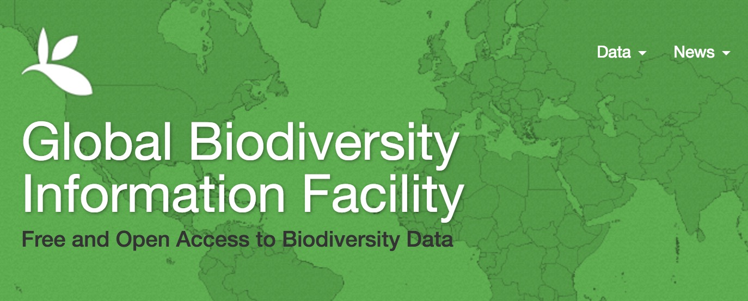

GBIF: gbif.org

Slide 16


Other Options for Data Downloads
API = Application Programming Interface
Allows users to interact with a system
Web Portal
API
Database
Interface

Slide 17
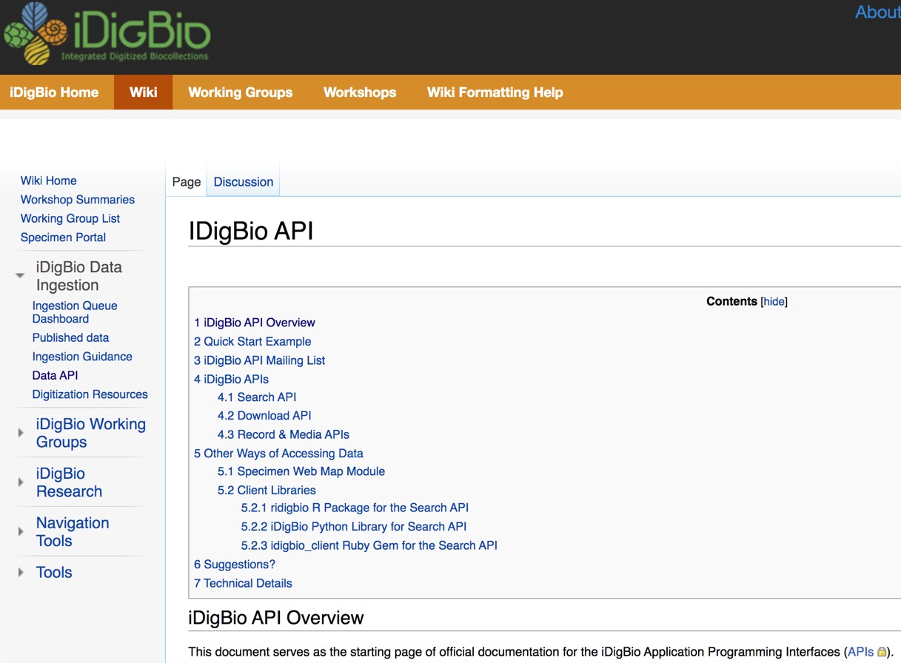
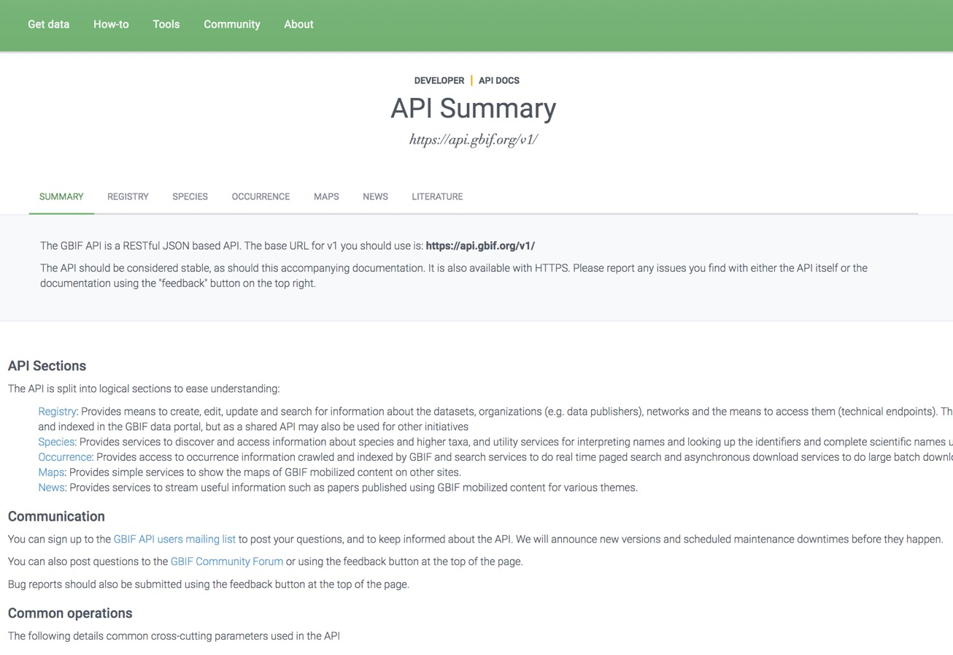
Other Options for Data Downloads: APIs

Slide 18

Other Options for Data Downloads: R packages
ridigbio
rgbif
spocc: Interface to Species Occurrence Data Sources
gatoRs: geographic and taxonomic occurrence R-based scrubbing
Patten et al. 2024, APPS

